Slide 1


Types of Data
Year 11

Slide 2
Topic: Types of Data
Date
EQ – What are the different types of data?
What is Data?
Data are observations or facts
When collected, organised and evaluated, it becomes information
Data can either be:
Categorical
Numerical

Slide 3
Topic: Types of Data
Date
EQ – What are the different types of data?
Categorical Data
Is data whose values are categories
Eg: blood groups (A, B, AB, O), house constructions types (brick, timber, concrete)
Two Types of Categorical Data
Ordinal
Nominal

Slide 4
Topic: Types of Data
Date
EQ – What are the different types of data?
Categorical Data
Ordinal
Takes values that can be logically ranked
Income Level: high, medium, low
Customer Rating: Satisfied, Unsatisfied
Nominal
Takes values which have no logical ranking
Country of Birth: Australia, New Zealand, Africa, America
Favourite Colour: blue, red, green

Slide 5
Topic: Types of Data
Date
EQ – What are the different types of data?
Numerical Data
Have values that describe a measurable quantity as a number, like how many or how much
Two Types of Numerical Data
Discrete
Continuous

Slide 6
Topic: Types of Data
Date
EQ – What are the different types of data?
Numerical Data
Discrete
Takes exact number values. Usually result of counting
Number of Apples: 0,1,2,3..
Number of tennis players: 2 or 4
Continuous
Can take any numerical value within a certain range. Usually result of measuring
Time taken to run 100m: 9.8 – 25 seconds

Slide 7
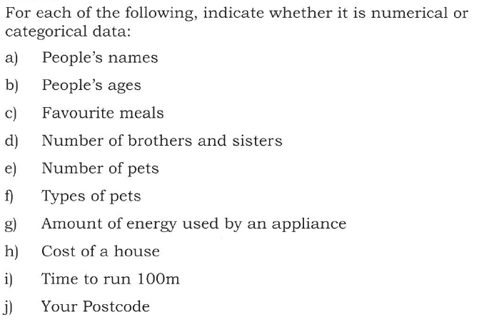


Examples

Slide 8
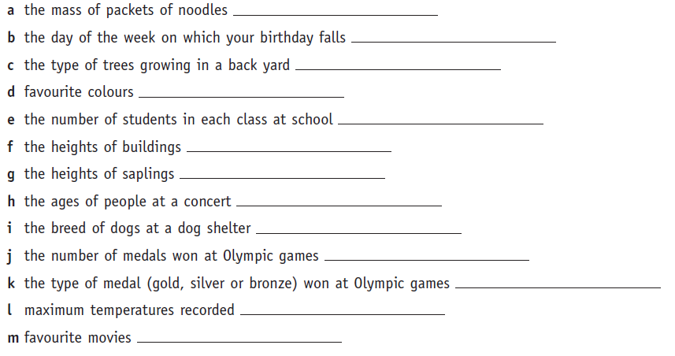
State whether the data is numerical or categorical. If numerical, also state whether it is discrete or continuous.

